Slide 1
Special Areas Curriculum
Art
Library
Music
World Languages
P.E.
Technology

Slide 2

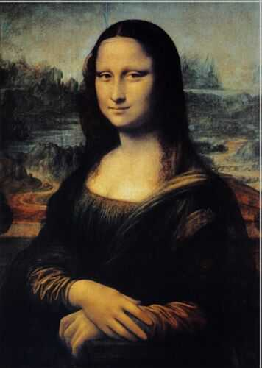
Art
Room 208
Grades 1- 8

Slide 3
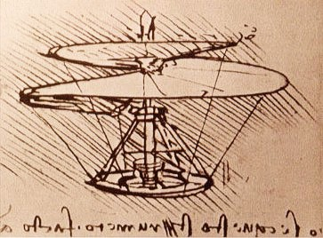
Class time is divided into two parts:
1. Art Learning Time which is time where we learn about artwork, artists
and cultures.
2. Art Making Time which is time where artists get to apply what they
have learned to a piece of their own work. Artists are always free to
take incomplete work home to extend their art making time.
What’s Art Class Like?

Slide 4
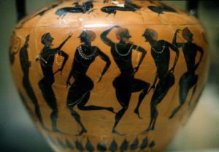

The National Standards for Arts Education state:
“In any civilization - ours included - the arts are inseparable from the very meaning of the term, 'education.' No one can claim to be truly educated who lacks basic knowledge and skills in the arts."
A balanced art curriculum derives its content from the art disciplines:
Two Dimensional
Three Dimensional
Criticism/Appreciation: Look, Analyze, & Talk
Color Theory
Art = educated

Slide 5


..
Makes you smART!
  A variety of themes, basic techniques & skills, artists, and art history are incorporated in all of our classes. Students will develop understanding of the creative process and gain skill in analyzing art.
  All classes will incorporate grade level appropriate discussion and analysis of the elements of art, the principles of design, art history and the art of other cultures.

Slide 6

National jr. Art Honor Society
National Jr. Art Honor Society is for 6th, 7th, and 8th grade students. It’s a national organization devoted to helping students grow as artists, to serve their community, and develop leadership skills. It’s a fun group with a purpose that meets Tuesdays after school. Watch for more information and sign-up forms coming home with your student.

Slide 7

To support your child’s interest in art:
Talk about the history of a special work of art in your own home - a quilt, a piece of pottery or a painting. Take a walk in your community, looking and talking about the buildings you and your child see. Encourage your children to talk about art. What do they like or not like and why?
Encourage your child's interest in art by providing materials and a place to create art.
Talk about art
Provide Materials
Encourage Creativity
Help your child come up with original ideas and build upon them. Be positive and give praise sincerely. Comment on its design or its originality. Ask the child questions about their artwork and display it.
Visit the local art museum. Watch for special events such as art fairs. First arouse your child's interest by talking about what you will see or do.
Stimulate interest
From the national PTA and the Getty Foundation for Education in the Arts.

Slide 8
Library
Mrs. Dever
jdever@valleyacademy.com

Slide 9

Library classes are scheduled for grades 1 - 8 once during each 6 day rotation. 1st & 2nd grades meet for 45 minutes. 3rd through 6th grades meet for 30 minutes. 7th and 8th grades meet for one hour.
Each student has an account in the school Library. Students may check out two (2) books at a time.

Slide 10
1st grade
During their class instruction, they will learn skills like book care and library manners.
They will also learn the difference between fiction and non-fiction.
They will learn how to identify parts of a book like the title, author, publisher, etc.
They will learn dictionary skill.
They will be involved in story time that focuses on our easy reader section of the library.

Slide 11
2nd Grade
During their class time, they will review the difference fiction and non-fiction.
They will look closer at non-fiction books like science, history, social studies, and the arts.
They will work on dictionary skills.
They will have story time that focuses on a variety of genres.
We will further discuss publishers, authors, etc.

Slide 12
3rd Grade
Students will learn call numbers and grouping by author or subject.
They become exposed to a variety of genres like biographies, history and social studies, poetry, and overview of fantasy.
They will discover the Dewey Decimal System and the reference center of the library.

Slide 13
4th-6th Grade
We focus on research techniques for academic reports.
4th grade: in-depth encyclopedia skills and introduction to concepts like keywords, guidewords, and topic selection
5th grade: reference tools and searching techniques
6th grade: using the Almanac to further their research skills that were introduced in earlier grades and learning to cite their sources

Slide 14
7th & 8th Grade
Learn organization and beneficial study techniques that will help them in older grade levels.
Review on topic selection and keywords when looking for academic reference material.

Slide 15

Music
Mrs. Loveless
Room 219
(next to the MPR)
heather.loveless@valleyacademy.com
https://valleyacademymusic.weebly.com/

Slide 16
Music Expectations:
Come to class (once every 6 days) with all supplies and a good attitude
Always give it your best
Don’t give up, just because you don’t succeed on your first try
Music knowledge builds
from year to year

Slide 17
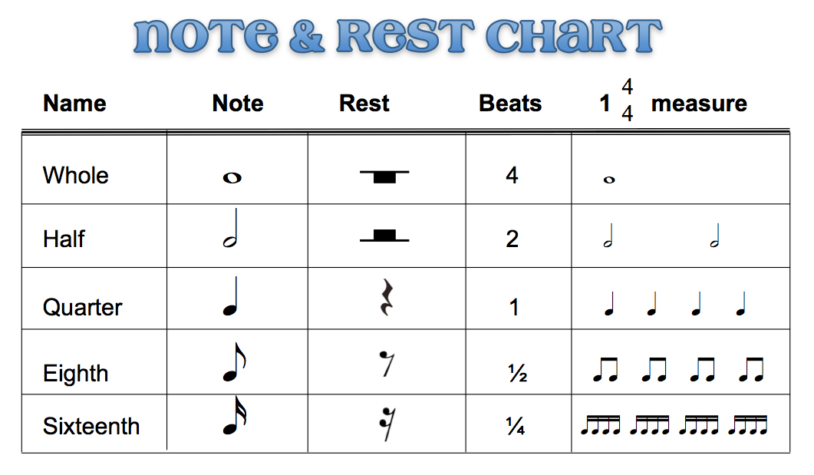
1st Grade
Twice every six school days
Notes & Rests Values
Instrument names & sounds
Singing
Dancing
Performing
This Photo by Unknown Author is licensed under CC BY-SA

Slide 18
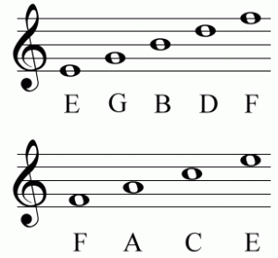
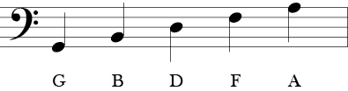
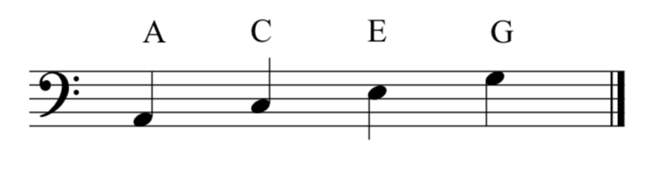
2nd Grade
Twice every 6 school days
Notes & Rests
Values
Parts of a Note
Bar Lines
Singing
Performing

Slide 19
3rd Grade
Basic Time Signatures
Counting in Music
The Treble Clef
Singing
Percussion
Performing

Slide 20
4th Grade
More Counting
Notes & Rests Values
Dynamics & Tempos
Singing
Performing

Slide 21

5th Grade
Music History
History of Rock n Roll
Musical Lingo
Performing
Dancing
Singing

Slide 22

6th Grade
Music Notation
History of Rock n Roll
Singing
Learning the Piano Keyboard
Performing
Dancing

Slide 23

7th Grade
Applying all previously learned information
Composing
History of Classical Music
Line Dancing (hopefully)
Learning Glockenspiels
This Photo by Unknown Author is licensed under CC BY

Slide 24
8th Grade
Tying Music to Core Classrooms
Time Signatures
Key Signatures
Sight Reading & Singing
History of Classical Music
Line Dancing (hopefully)
Learning Glockenspiels

Slide 25


How to help your student in music
Listen to a variety of music daily
Ask:
What did you learn in music today?
Do you have any homework?
Need classroom help?
Email or call Mrs. Loveless with questions or concerns: heather.loveless@valleyacademy.com
    623-516-7747 ext. 219

Slide 26
World Languages
Valley Academy is pleased to continue on with Rosetta Stone as our classroom and online language learning tool!

Slide 27
Why Rosetta Stone?
Multilingual skills are a critical success factor in our global economy.
We want to provide our students the language skills they need to be effective and successful in today’s market.
Rosetta Stone’s® interactive and award-winning software creates an intuitive and engaging environment for thinking and communicating in a new language.
A customizable curriculum allows instructors to design plans for students at different levels and with different language learning goals.

Slide 28
Students will have access to the following:
Language Training: Reading, writing, speaking and listening skills are introduced in core lessons, then key skills, such as grammar and vocabulary, are refined in focused activities. Speech recognition technology evaluates the pronunciation of each word and sentence, providing immediate feedback.
Rosetta Stone Language Training for Apple and Android: Students will be able to continue their language training via our mobile app. Progress made in this application syncs with progress in the program, and vice versa. Note: The Rosetta Stone Language Training mobile app is available for select languages only.

Slide 29
Accessing Your Child’s Rosetta Stone Account:
On PC or Laptop:
https://reidtraditional.rosettastoneclassroom.com/en-US
(this link is on the “Home Access” page on my class website)
On Smartphone or Tablet:
Download Rosetta Stone® app.
Click on “Sign in” (NOT “Create an Account”).
Click on “Work or School Use”.
Username: 6-digit number in your child’s school Google email address.
Password: the same 6-digit number as the username.
Namespace: “reidtraditional”.
*Please note: the app format will appear different from the computer format*

Slide 30
Questions about Rosetta Stone® or my class?
Explore my Classroom Website:
https://sites.google.com/valleyacademy.com/worldlanguages/home.
It will answer MANY of your questions, and the link to the Rosetta Stone® sign-in page is there.
Log into your child’s Rosetta Stone® account (with their 6-digit number), and go through one “Core Lesson” with them. It will help you understand how to the program works.
Email me:
cferris@valleyacademy.com

Slide 31
My Contact Information:
Mrs. Ferris
cferris@valleyacademy.com
Office: World Languages Room 209

Slide 32

Physical Education
Physical Education
A major goal of the physical education curriculum is to develop personal activity and fitness habits that students can use in all areas of their lives. In addition, my goal is to use Physical Education as a tool to build self-confidence and to teach students to respect each other regardless of their individual capabilities. This year students will learn about individual sports and team sports. They will enjoy games such as basketball, volleyball, and flag football. Students will also participate in the Presidential Fitness Contest, run a timed mile and enjoy a track and field day.

Slide 33
Physical Education
1st -8th grade- Coach Mims
1st and 2nd grade: 30 minute classes
3rd-8th grade: 60 minutes

Slide 34
Physical Education
P.E. is always fun as long as you follow the rules
P.E. classroom rules
Have respect for your teacher and fellow students
Use equipment like you are told to use it
Demonstrate good sportsmanship
Display a positive attitude
Dress properly for P.E.
Absolutely NO dress shoes on the new gym floor

Slide 35
Grading System
Students can earn a maximum of 10 points each day.
  2 points for being prepared for class
  2 points for demonstrating good sportsmanship
  2 points for good teamwork
  4 points for positive attitude and good effort in all activities

Slide 36
Grading System continued
Grades 1-5 are graded 90% on this daily point scale and 10% on projects
Grades 6-8 will have 10% of their grade based on tests, 10% on projects, and 80% from their daily points

Slide 37
School Sports
Open to all Valley Academy students 5th grade through 8th grade
Fall Sports Season
September through November
Flag Football
Volleyball

Slide 38
School Sports
Open to all Valley Academy students 5th grade through 8th grade
Winter Sports Season
November through February
Boys’ Basketball

Slide 39
School Sports
Open to all Valley Academy students 5th grade through 8th grade
Spring Sports Season
March through May
Girls’ Basketball
Co-ed Soccer

Slide 40
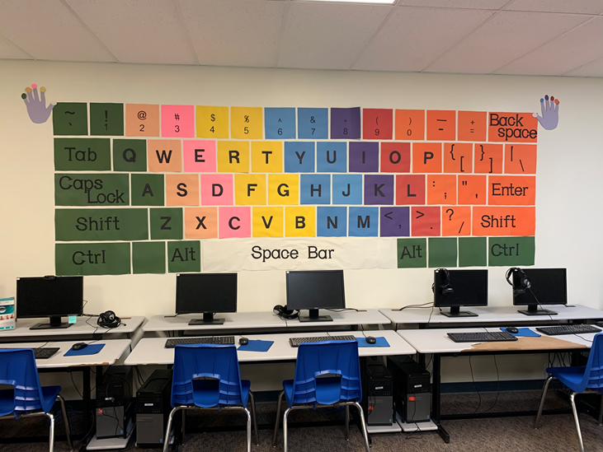
technology
Mrs. Lander
Students will participate in Technology once every 6 school days.

Slide 41
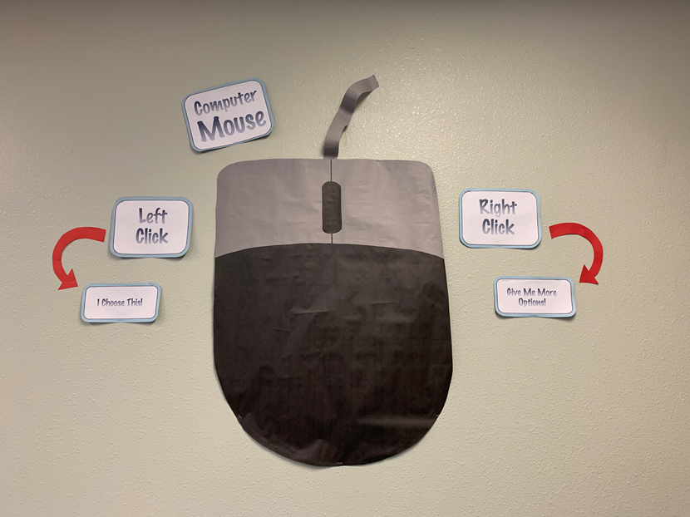
3rd Grade
Third grade is an important year in the Technology Classroom! Many of the students will be introduced to the computer for the first time while others have already had some experience.
Digital Citizenship
Basic Computer Knowledge
File Manipulation
Keyboarding with Correct Finger Placement
Introduction to Google Classroom
Introduction to Google Products (Docs)
Coding
Basic Troubleshooting and Connection​

Slide 42

4th Grade- 8th grade
Digital Citizenship and Internet Safety
Expand on Google Products (Docs, Slides, Sheets)
Project based learning through the TechnoKids program
Increase keyboarding skills with Typing Club
Research and citing sources
Coding
Older students will eventually work with 3D Printing
This Photo by Unknown Author is licensed under CC BY-SA-NC

Slide 43

Coursework Grading
Participation | 60%
Assignments | 30%
Quizzes | 10%
This Photo by Unknown Author is licensed under CC BY-NC-ND
This Photo by Unknown Author is licensed under CC BY-NC-ND

Slide 44
Open Lab
Open Lab is available during the student’s lunch recess. They should bring their folder, passwords and any other materials needed.
Open Lab is to work on school work. No computer games are allowed.

Slide 45

Contact Information
Mrs. Lander
tlander@valleyacademy.com
Website Address: https://sites.google.com/valleyacademy.com/technologyclass/home
or can be found on the Valley Academy website under Quick Links
This Photo by Unknown Author is licensed under CC BY-SA-NC

